Slide 1

Electrical Fault Classification
Chad Hucey | Deep Suchak | Isha Jain | Tanish Kandivlikar

Slide 2

Table of contents
Problem statement
Dataset
Exploratory Data Analysis
Feature Engineering
Machine Learning
Results
Challenges
Conclusion

Slide 3




Problem Statement
Distribution Systems are dynamic and complex
Faults and/or disruptions of service can happen frequently
Operators need to be able to accurately detect different faults and resolve them quickly
Accurately predict 6 types of faults

Slide 4
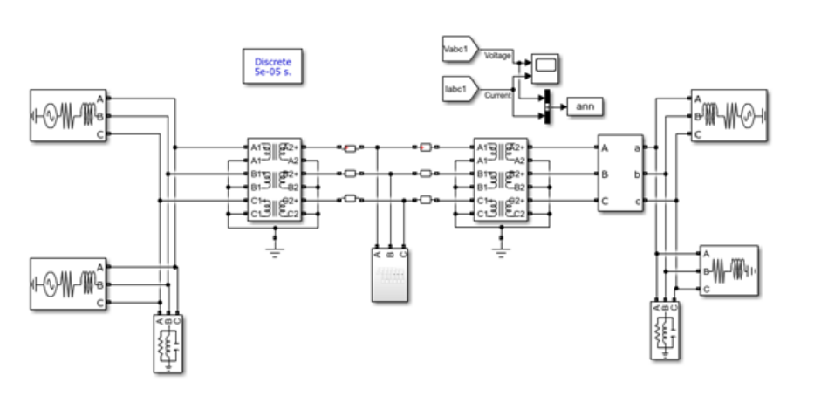
Dataset
Obtained from Kaggle
6 features
Current and voltages in the three lines
4 output columns
{G C B A}
Combined to create the Target Variable
Output Column | Meaning | Output Entry
G | Ground | 0 = not fault, 1 = fault
C | Line C | 0 = not fault, 1 = fault
B | Line B | 0 = not fault, 1 = fault
A | Line A | 0 = not fault, 1 = fault
Prakash, E Sathya. “Electrical Fault Detection and Classification.” Kaggle, 22 May 2021, www.kaggle.com/datasets/esathyaprakash/electrical-fault-detection-and-classification/?select=classData.csv.
Notes:
These are speaker notes

Slide 5
Classes
Format [G C B A}:
[0 0 0 0] - No Fault
[1 0 0 1] - LG fault (Between Phase A and ground)
[0 1 1 0] - LL fault (Between Phase B and Phase C)
[1 0 1 1] - LLG Fault (Between Phases A,B and ground)
[0 1 1 1] - LLL Fault (Between all three phases)
[1 1 1 1] - LLLG fault (Three phase symmetrical fault)

Slide 6
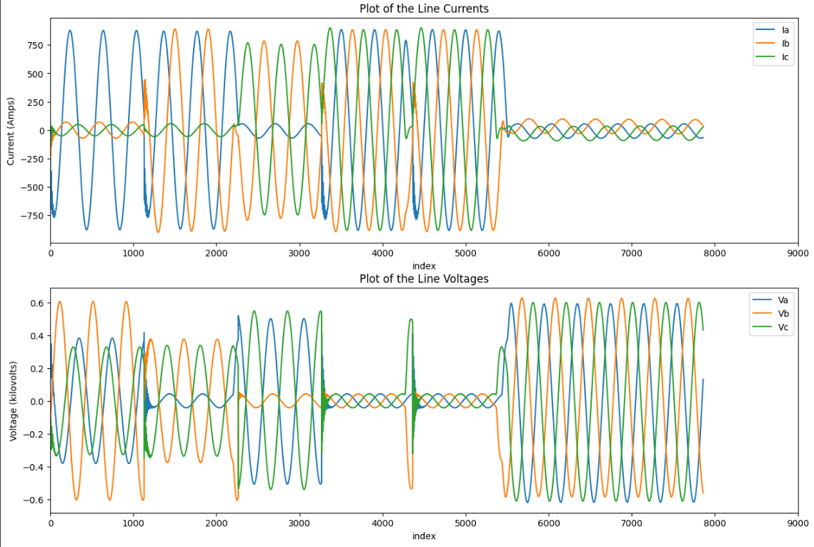
Exploratory Data Analysis
7861 rows and 10 columns
No missing values
Periodic data

Slide 7
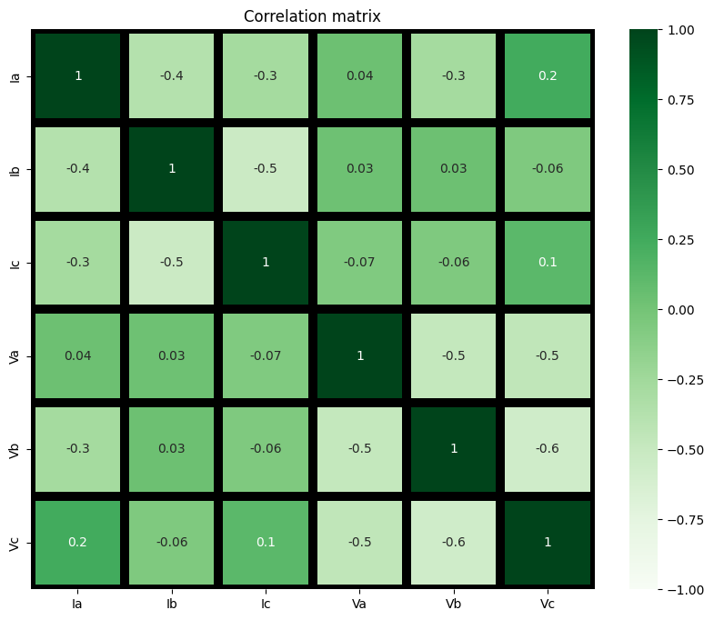
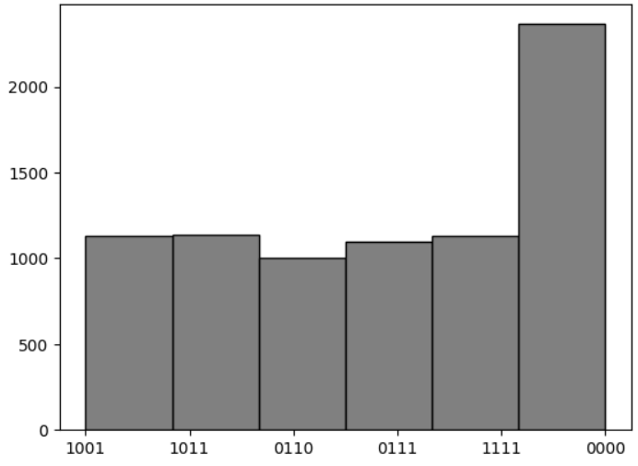
EDA Continued

Slide 8
Feature Engineering
Used the 6 given features as predictors, and the combined output column as the target
x
2x
1
0
-x
0
0
Original Data
Data points >= 0
Scaled from 0 to 1

Slide 9



Machine Learning
Logistic Regression:
K-Nearest Neighbors (KNN):
Decision Tree:
Tested if the faults can be separated by linear boundaries in feature space
Served as a baseline to measure the performance of more complex models
KNN could effectively classify faults by looking at 'nearby' instances in the feature space
Performs feature selection implicitly, which can be beneficial if some features are more indicative of faults than others
A decision tree uses thresholds to make decisions, making it a good fit for data with clear rule-based patterns.

Slide 10


Machine Learning
Random Forest:
Support Vector Machine:
Electrical fault detection can be complex and might not be well-modeled by a single decision tree.
Random forests can capture a wider range of fault signatures by combining the learning power of multiple trees.
SVMs can model complex, non-linear relationships using the kernel trick, and they focus on maximizing the margin, which can lead to better generalization.
The ability of SVMs to use different kernels allows them to model the complex boundaries that could occur in the feature space of electrical signals.

Slide 11
Results
Baseline Models
Tuned Models
Logistic Regression
”multiclass” = multinominal
65%
Logistic Regression
”multiclass” = multinominal
65%
KNN
“n_neighbors” = 5
79.3%
KNN
“n_neighbors” = 8
82.25%
Decision Tree
“max_depth” = 10
83.3%
Decision Tree
“max_depth” = 17
85.69%
Random Forest
“n_estimators” = 100
87.2%
Random Forest
“n_estimators” = 400
87.33%
Support Vector Machine
“kernel” = rbf
76.1%
Support Vector Machine
c = 100, gamma = 1, kernel = rbf
83.26%

Slide 12
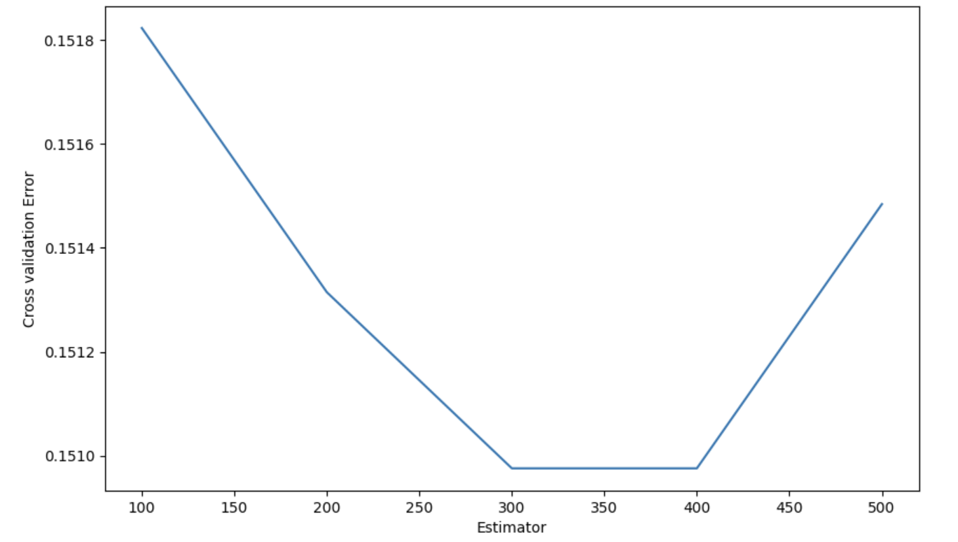
Cross Validation and its Importance
Definition:
Cross-validation is a key method in machine learning, assessing how well a model predicts new data. Instead of a single data split, it divides the dataset into subsets, training on one and testing on another in an iterative process. This thorough evaluation ensures the model's performance and reliability across diverse data scenarios.
Importance:
Cross-validation is crucial for three main reasons.
- it ensures a model can generalize, making accurate predictions on unseen data.
- it provides a robust assessment of real-world performance by testing the model on various data subsets.
- it cross-validation helps prevent overfitting, where a model may memorize the training data but struggle with new data.
cross-validation error v/s number of estimators in Random Forest Classifier

Slide 13

Challenges
Poor performance of logistic regression model
Due to high bias
Too simple for this application
Would likely need more sophisticated feature engineering
Notes:
Some of the challenges we came across included poor performance of the logistic regression model
The original model trained using a standardized version of the predictors/training set led to a test accuracy of roughly 25%.
The model was also re-trained with values between 0 and 1, as mentioned in Feature Engineering. This boosted the test accuracy to 65%.
A cosine transformation was applied to the predictors as well to try and capture the periodic nature, however this approach led to the test accuracy dropping to 63%, probably due to the introduction of more bias as the values of cosine range from -1 to 1.
It was evident that our implementation of Logistic Regression was too simple for this application, and a more flexible approach with more sophisticated feature engineering would be needed to further improve the performance of a Logistic Regression model.

Slide 14
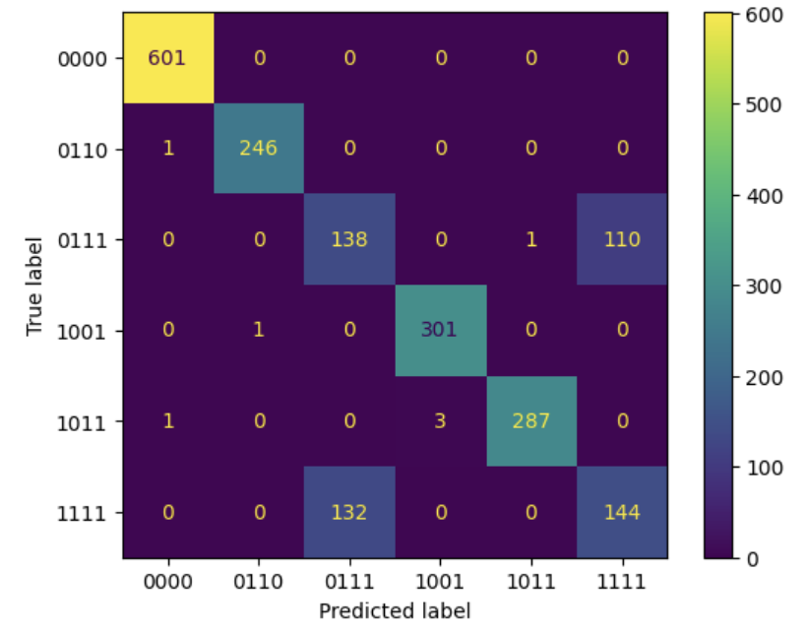
Challenges Continued
Difficulty differentiating between class 0111 and 1111
Predicted class “0111” 270 times
Incorrect 132 times
Predicted class “1111” 254 times
Incorrect 110 times
[0 1 1 1] - LLL Fault (Between all phases, A, B and C)
[1 1 1 1] - LLLG fault (Between phase A, B, C and Ground)
Notes:
Another challenge we faced was the difficulty differentiating between 2 faults namely, class 0111 and 1111
Consider this confusion matrix in which the tuned Random forest model predicted a fault between line A, B and C (class 0111) 270 times but the true labels for 132 of those predictions were class 1111. It can also be seen that class 1111 was predicted 254 times but the true labels for 110 of those predictions were for class 0111. A similar trend can be observed from the confusion matrix for the other 3 models as well. This outcome is problematic since the models cannot accurately predict those two classes, however, it can be explained by the data,

Slide 15
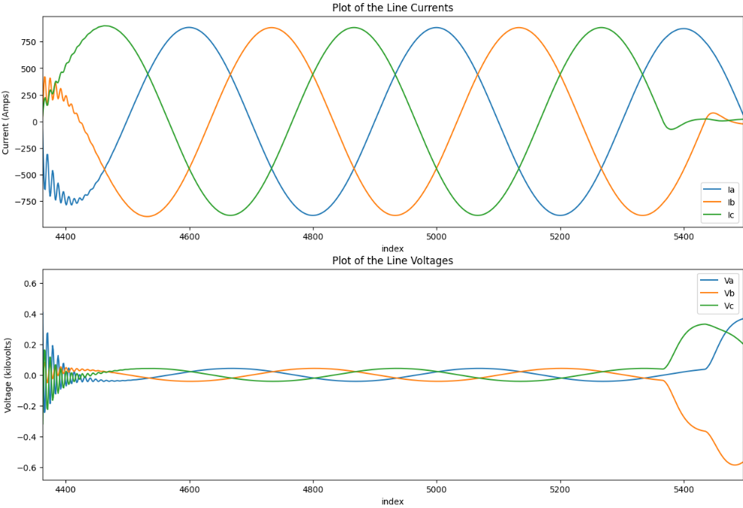
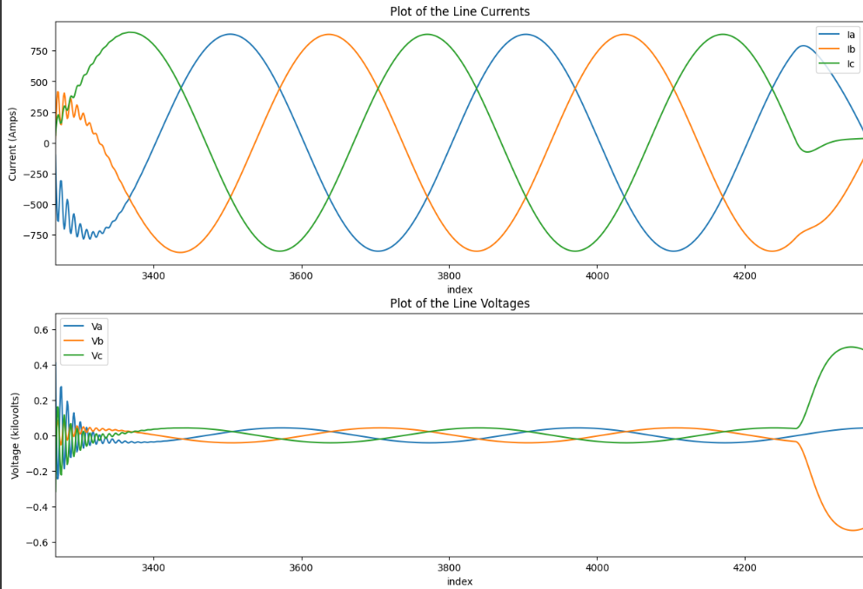
Class 0111 vs 1111
Class 0111
Class 1111
Very similar trends
ML models struggled to accurately predict these two classes
Notes:
The figure alongside shows the current and voltage profiles for class 0111 on the left and for class 1111 on the right. Both profiles are very similar, which means that the models are learning similar trends for both classes. As a result, if a data point shows trends similar to that of the figure, the models are unsure whether to classify that data point as class 0111 or 1111. To address this issue, more training samples might help to better identify any hidden trends of these classes. Additionally, more flexible models like neural networks could also be used.

Slide 16






Conclusion
Through rigorous experimentation, we observed distinct performances across different models
Logistic Regression, while simple and effective for linear relationships, may fall short in capturing the non-linear intricacies of electrical fault data
K-Nearest Neighbours and Support Vector Machines performed well but were outperformed by Random Forests
Decision Trees, though capable of capturing complex patterns, exhibited a tendency to overfit to our dataset
Notably, Random Forest emerged as the most robust performer, effectively balancing complexity and generalization
Future works could involve gathering more data and/or more sophisticated techniques
Notes:
In conclusion, distinct performances for the various models were observed, with logistic regression falling short for capturing the trends in the electric fault dataset. K-Nearest Neighbours and Support Vector Machines performed better but were outperformed by Random Forests whereas decision trees exhibited a tendency of overfitting to the dataset. Random forest appeared to have the best performance. Future works could focus on using more sophisticated techniques if a larger quantity of data is made available.

Slide 17
THANK YOU!
ANY QUESTIONS?

